Slide 1
Technical Overview
February 2018
John Matthews jmatthews@redhat.com
Technical Lead for Automation Broker

Slide 2
Agenda
Introduction/Background Info
Kubernetes Service Catalog
Brokers and Open Service Broker API
Automation Broker and Ansible Playbook Bundles (APBs)
Walk through Workflow of Catalog<->Broker<->APB
Benefits of Automation Broker
Overview of creating an APB
Development Environments installing Broker
Links to more info

Slide 3
Introduction/Background Info

Slide 4
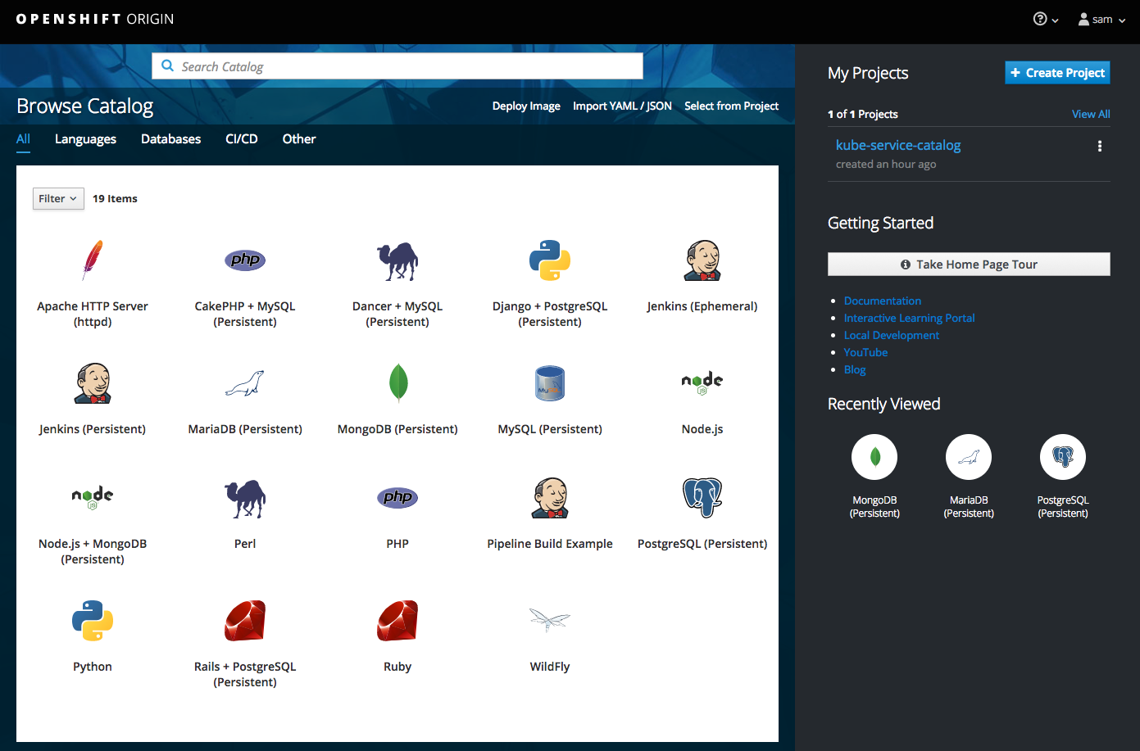
Service Catalog (kubernetes-incubator/service-catalog)
Where Services are Published
Better experience for service consumers
Streamlines “getting started” process
Task focused
Key call outs
Unified search
Guided workflow
Provision and manage services from a central interface
Search option ensures quick access to all services

Slide 5




What is a Service Broker?
SERVICE CONSUMER
SERVICE
CATALOG
SERVICE
BROKER
SERVICE
PROVIDER
Brokers inform Service Catalog of the Service Classes it can provision
Service Consumer only interacts with Service Catalog, the details of the Brokers are largely hidden
Creates a process that is automated, standardized, and most importantly consistent

Slide 6



Service Catalog and Brokers
Expose and Provision Services
OpenShift
Template
Broker
OPENSHIFT
OpenShift
Templates
OpenShift Ansible
Broker
ANSIBLE
Ansible Playbook Bundles
AWS
Service
Broker
AMAZON WEB SERVICES
NEW!
Public
Cloud Services
Other
Service
Brokers
OTHER COMPATIBLE SERVICES
Other
Services
OPENSHIFT SERVICE CATALOG
SERVICE BROKERS
Notes:
Brokers inform Service Catalog of the Service Classes it can provision
End User only interacts with Service Catalog, the details of the Brokers are hidden
Service Brokers are not necessarily restricted to provisioning/handling services that live inside OpenShift.
Service Catalog supports and can connect to multiple brokers
The Template and Ansible brokers will be included with OpenShift by default.
Any Open Service Broker API compatible broker would be able to expose services into the catalog.
Service Brokers are not necessarily restricted to provisioning services that live inside OpenShift nor do they need to run inside the cluster
AWS Service Broker available from Amazon
Note: More information about the OpenShift Template Broker is available later in the presentation.

Slide 7







Open Service Broker API
Defines an HTTP interface between the services marketplace of a platform and service brokers
Background
Working group formed in September 2016; successor to Cloud Foundry Service Broker API
Multi-vendor project to standardize how services are consumed on cloud native platforms across service providers
Service Broker is the component that implements the API, for which a platform's marketplace is a client
Methods
Service brokers are responsible for advertising catalog of service offerings and service plans to the marketplace, and acting on requests from the marketplace for:
Catalog - Return service offerings
Provision - Create service
Deprovision - Delete service
Bind - Obtain credentials/coordinates for service
Unbind - Revoke credentials for service
Update - Upgrade service plan or parameters
Notes:
Defines a standard api for advertising services to a service catalog, and creation and connection to those services.
API working group formed in September 2016, officially announced December; successor to CF Service Broker API
API defines an HTTP interface between the services marketplace of a platform and service brokers
Service Broker is the component of the service that implements the Service Broker API, for which a platform's marketplace is a client
Service brokers are responsible for advertising a catalog of service offerings and service plans to the marketplace, and acting on requests from the marketplace for:
Provisioning, binding, unbinding, and deprovisioning
Provisioning reserves a resource (service instance)
Binding typically generates credentials necessary for accessing the resource or provides the service instance with information for a configuration change
Platform marketplace may expose services from one or many service brokers
Individual service broker may support one or many platform marketplaces using different URL prefixes and credentials
Backed by numerous industry leaders including Fujitsu, Google, IBM, Pivotal, Red Hat, and SAP

Slide 8

Automation Broker / OpenShift Ansible Broker
Orchestrating OpenShift Services
Define, extend, and deliver “simple” to “complex” multi-container OpenShift services
Standardized approach to using Ansible to manage and provision applications
Leverage existing investment in Ansible roles/playbooks
Automation Broker
Ansible Playbook Bundle
Implementation of Open Service Broker API
Exposes services to Service Catalog
Provisions services using Ansible
Use cases:
Traditional S2I deployments
Provisioning of pre-existing images
Orchestration of external services
Deploying multi-service solutions
Lightweight application definition (meta-container)
Simple directory employing:
Named playbooks [provision.yml, bind.yml, …] to perform Open Service Broker actions
Metadata containing a list of required / optional parameters during deployment
Embedded Ansible runtime

Slide 9


Automation Broker Workflow
High Level Architecture
OpenShift Service Catalog
APB services:
• MediaWiki (Example)
• PostgreSQL (RHSCL)
• MariaDB (RHSCL)
• MySQL (RHSCL)
Supports provisioning and binding of both on and off-platform (public cloud) services!
Red Hat Container Catalog
Ansible Playbook Bundle
Service Consumer
• catalog
• provision
• deprovision
• bind
• unbind • update
Automation
Broker
Ansible Playbook Bundle
Provisioned Service
Service Broker
Service Broker
Other Service Brokers
Notes:
APBs can be used to deliver/orchestrate on-platform services, but could also be used to provision and orchestrate off-platform services (eg: from cloud providers, IaaS, etc)

Slide 10
Ansible Playbook Bundle (APB) Definition
Application Definition Format
Ansible Playbook Bundle (APB) Definition
Short-lived, lightweight container image consisting of:
Simple directory structure with named “action” playbooks
Metadata:
Required/optional parameters
Image dependencies (provision vs bind)
Service plans
Specification version
Ansible runtime environment
Designed to orchestrate pre-existing containerized application images
Developer tooling available for simple, guided approach to APB creation
Easily modified or extended
Several example APB’s available for popular RHSCL services
Minimal RHEL Image
Directory of files
provision.yaml
Deployment Role
deprovision.yaml
Ansible Runtime
bind.yaml
unbind.yaml
update.yaml
test.yaml
apb.yaml
provision.yaml = Install
deprovision.yaml = Uninstall
bind.yaml = Grant
unbind.yaml = Revoke
update.yaml = Upgrade
test.yaml = Test
abp.yaml = Metadata
Notes:
Developing APBs can be done in one of two ways: Creating the APB container image manually using standardized container creation tooling, or with APB tooling that RH will deliver that provides a guided approach to creation.
Two APB examples are provided to demonstrate both service provisioning as well as binding to an existing service using an APB.

Slide 11
Benefits of the Automation Broker and APBs
Abstracts OSB API details……….focus on a simple contract, ‘Service Bundle’
Provision, Deprovision, Bind, Unbind, Update
‘Service Bundle’ contract is lightweight
Executable Image first argument passed in corresponds to method to invoke
For Ansible Playbook Bundles (APBs)
Each method is backed by a playbook to execute.
Extensible for other Service Bundle implementations, i.e. Bash, Java, Puppet, Salt, etc
Decouples release cycle of Broker vs Content
Think of analogy of yum/dnf and RPMs
Broker acts as the infrastructure for managing services
Broker is updated each release of OpenShift
APBs are the content of the services to be consumed
APBs are updated as desired by product team

Slide 12
Overview of Creating an APB

Slide 13


ANSIBLE PLAYBOOK BUNDLE (APB)
Steps to create an APB:
Run: apb init
Generates skeleton
Edit: Ansible playbooks/roles
Edit as desired for your use case
Edit apb.yml
to expose parameters and plans
Format is documentated here
Run: apb prepare
to update Dockerfile with image labels
Build container
apb build or docker build .
Push to a registry
Notes:
Could call out apb.yml similar to RPM spec file
Then for Dockerfile, could mention how the apb.yml gets encoded as a label on the image to help the broker with learning about APBs published to a registry

Slide 14


ANSIBLE PLAYBOOK BUNDLE (APB)
abp.yaml
name: helloworld-apb image: myorg/helloworld-apb
parameters: - name: namespace type: string default: hello-world-apb
- name: message type: string default: "Hello World"
abp.yml
playbooks
provision.yml
deprovision.yml
Dockerfile
Notes:
Could call out apb.yml similar to RPM spec file
Then for Dockerfile, could mention how the apb.yml gets encoded as a label on the image to help the broker with learning about APBs published to a registry

Slide 15
ANSIBLE PLAYBOOK BUNDLE (APB)
Concept only, current APBs will not actually create/delete a namespace
provision.yml
- name: Deploy sampleapp hosts: localhost connection: local tasks: - name: create namespace shell: "oc new-project {{ ns }}" - name: create app dc shell: "oc create -n {{ ns }} -f sampleapp.yml"
abp.yml
playbooks
provision.yml
deprovision.yml
Dockerfile

Slide 16
ANSIBLE PLAYBOOK BUNDLE (APB)
Concept only, current APBs will not actually create/delete a namespace
deprovision.yml
- name: Uninstall sampleapp hosts: localhost connection: local tasks: - name: delete namespace shell: "oc delete project {{ ns }}"
abp.yml
playbooks
provision.yml
deprovision.yml
Dockerfile

Slide 17
ANSIBLE PLAYBOOK BUNDLE (APB)
com.redhat.apb.spec is BASE64 encode of apb.yml
apb prepare will keep this updated
Dockerfile - Ansible runtime for base image
FROM ansibleplaybookbundle/apb-base
LABEL "com.redhat.apb.version"="0.1.0" LABEL "com.redhat.apb.spec"=”...<base64 encoded apb.yml data >…”
ADD roles /opt/ansible/roles ADD playbooks /opt/apb/actions RUN useradd -u 1001 -r -g 0 -M -b /opt/apb -s /sbin/nologin -c "apb user" apb RUN chown -R 1001:0 /opt/{ansible,apb} USER 1001
abp.yml
playbooks
provision.yml
deprovision.yml
Dockerfile
Notes:
Com.redhat.apb.spec allows an efficiency in querying metadata from a remote registry without needing to download the entire image.
The label contains the contents of apb.yml which has the metadata the Broker requires to satisfy Service Catalog information.
I.e. this helps the Broker to avoid needing to download each APB just to inform Service Catalog of available offerings.

Slide 18
APB Examples:
Upstream Examples at
https://github.com/ansibleplaybookbundle
Hello World
https://github.com/ansibleplaybookbundle/hello-world-apb
Postgres
https://github.com/ansibleplaybookbundle/postgresql-apb
Mediawiki
https://github.com/ansibleplaybookbundle/mediawiki-apb
AWS APB Examples:
https://github.com/search?q=org%3Aawslabs+servicebroker
~10 APBs published and made public as of reInvent Nov 2017

Slide 19
Development Environment

Slide 20
Development Environment: OpenShift Focused
oc cluster up
Then execute: run_latest_build.sh
In github: openshift/ansible-service-broker/master/scripts/run_latest_build.sh
minishift
Follow guide: docs/minishift.md
Example YouTube Video:
Using the Ansible Broker with Minishift
openshift-ansible
https://github.com/openshift/openshift-ansible/tree/master/roles/ansible_service_broker
Vagrant Env updated on each release of OpenShift
https://gitlab.sat.lab.tlv.redhat.com/rhci/vm_env/tree/master/openshift
fusor/catasb
Ansible scripts that use oc cluster up and deploy the Broker
Handle edge cases and tweaks for Broker developers
Automates ec2 instance creation, letsencrypt certs, etc for demos

Slide 21
Development Environment: Kubernetes Focused
Work in Progress
Original effort was pure OpenShift focused
Recent sprints have added support for pure k8s
fusor/catasb
Ansible scripts that use oc cluster up and deploy the Broker
Handle edge cases and tweaks for Broker developers
Automates ec2 instance creation, letsencrypt certs, etc for demos
Run the local scripts with -k
“./reset-environment.sh -k”

Slide 22
Recommended Blog Posts

Slide 23
Blog Posts to read for an APB Developer
Up and Running with the OpenShift Ansible Broker
APB Development Tutorial – MediaWiki 1.23 + PostgreSQL 9.5
Optional...below looks at APB development from ISV/Partner perspective
Rocket.Chat Ansible Playbook Bundle Development & Deployment Tutorial

Slide 24
Links to More Info

Slide 25
Kubernetes Service Catalog - Links
Kubernetes Service Catalog Upstream
https://github.com/kubernetes-incubator/service-catalog
Red Hat is leading community effort
Paul Morie is Red Hatter moving this forward
More info on Service Catalog (OpenShift Commons talks from Paul Morie)
OpenShift Commons Briefing #105: Service Catalog Update with Paul Morie (Red Hat)
OpenShift Commons Briefing #106: Service Catalog on OpenShift 3.7 Deep Dive with Paul Morie (Red Hat)

Slide 26
Automation Broker - Links
Upstream Landing Page
http://automationbroker.io/
Github
https://github.com/openshift/ansible-service-broker
Trello
https://trello.com/b/50JhiC5v/ansible-service-broker
Getting Started Docs
https://github.com/openshift/ansible-service-broker#getting-started-with-the-ansible-service-broker
Blog Posts
Up and Running with the OpenShift Ansible Broker
https://blog.openshift.com/category/technologies/service-catalog/
Posted on openshift blogs under ‘service-catalog’

Slide 27
Ansible Playbook Bundle - Links
APB Spec
https://github.com/ansibleplaybookbundle/ansible-playbook-bundle/blob/master/docs/developers.md#apb-spec-file
Examples
Upstream: https://github.com/ansibleplaybookbundle
AWS: https://github.com/search?q=org%3Aawslabs+servicebroker
~10 APBs published and made public as of reInvent Nov 2017
Blog Posts
APB Development Tutorial – MediaWiki 1.23 + PostgreSQL 9.5
Rocket.Chat Ansible Playbook Bundle Development & Deployment Tutorial
apb tool
apb CLI docs
Install: pip install apb

Slide 28
Contact Info for Automation Broker Team
Email List
https://www.redhat.com/mailman/listinfo/ansible-service-broker
ansible-service-broker@redhat.com
Please subscribe to receive announcements of new features/enhancements
IRC: #asbroker on Freenode
http://webchat.freenode.net/?channels=%23asbroker
Twitter
https://twitter.com/autom8broker
Youtube
https://www.youtube.com/channel/UC04eOMIMiV06_RSZPb4OOBw/videos
Individuals
Product Management: Eric Dube, edube@redhat.com
Engineering Management: Todd Sanders, tsanders@redhat.com
Technical Lead: John Matthews, jmatthews@redhat.com

Slide 29
Source-to-Image for Ansible Playbook Bundle (APB)
Source-to-Image for Ansible Playbook Bundle (APB)
https://www.youtube.com/watch?v=ZhLvlpqHI8U
Using Openshift, gitlab and Jenkins as pipeline-as-code - Yusuf Hadiwinata
https://www.youtube.com/watch?v=BAzvuFr73zc
Running open source DevSecOps using GitHub, Jenkins, Aqua, OpenShift, and SonarQube
https://www.youtube.com/watch?v=okSoQAuuo6Y

